Slide 1


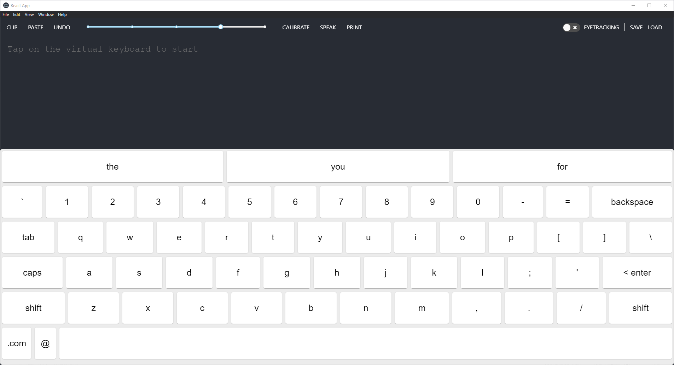
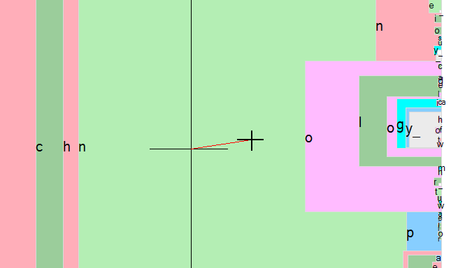
ASL Eye-Tracking
Kosta, Steven., Le, Thanhthao., Su, Zixiu., Vardaro, Anthony.
CSE – Senior Design
Executive Summary
Experimental Goals
Experimental Results
The ASL Eye-Tracker is a software designed to help the user communicate with others by using only their eyes. The software provides a keyboard that the user can input just by moving their eyes. Series of words are displayed based on the user’s input.
Specifications:
Tracks User’s Eye Movement
Display Keyboard
Enable User’s Input to Enter Words by using their Eyes
Recalibration Eye Tracker
Predictive Text
Constraints:
Communication Delays
Limited Equipment For Testing
Conceptual Design:
Software Calibrate with the Eye-Tracker
User Enter a Letter/Word with their eyes
Text will appear (predictive) / (User’s Input)
- Eyetracking keyboard
- Predictive text
- Text-to-speech
- Manuel and automatic calibration
- Configurable eyetracking precision settings
Background
Some patients are unable to move their body, except for their eyes. This can affect the communication between the staff and their patients. The ASL Software is designed to help improve that barrier. A similar software with this project is a software called “Dasher”; however, the ASL Software is designed to improve the User-Interface, so that the user is comfortable using the software.
Experimental Test Plan
- The software is built in React within Electron.
- UI Keyboard with eyetracking integration.
- Predictive text for easier typing
- Speech-to-text integration
- Save/load state
- Manuel and automatic recalibration routines.
- User settings cache.
Conclusions
The ASL Eye-Tracking Software is created to help users communicate with others using their eyes. The User Interface is more friendly, so the user can understand where to look at while interacting with the application.

